Slide 1
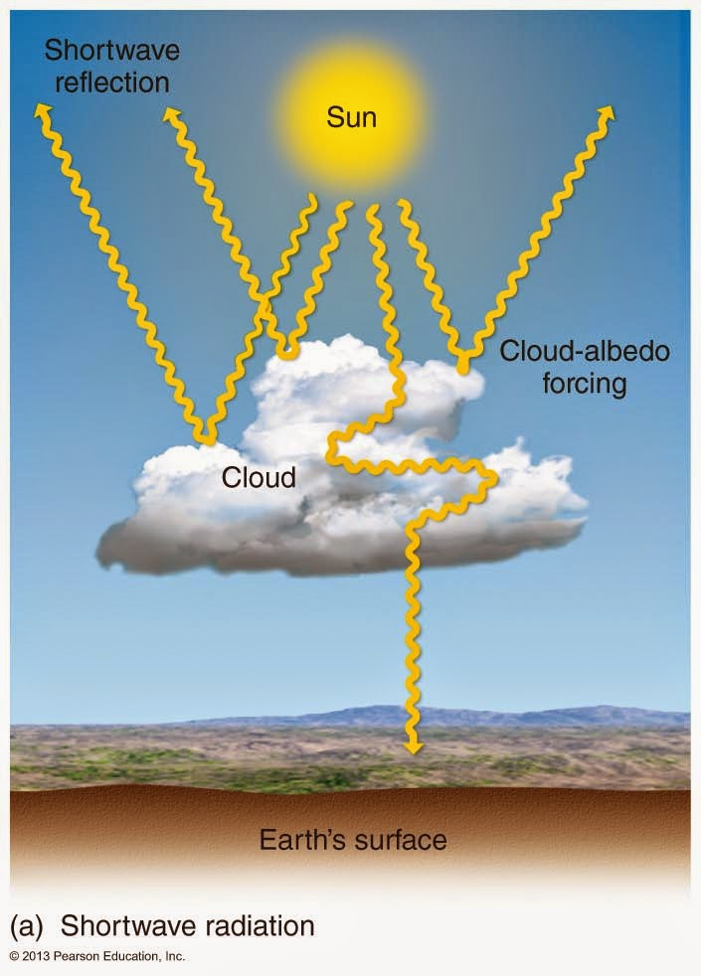
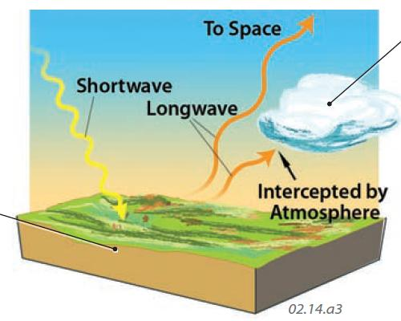
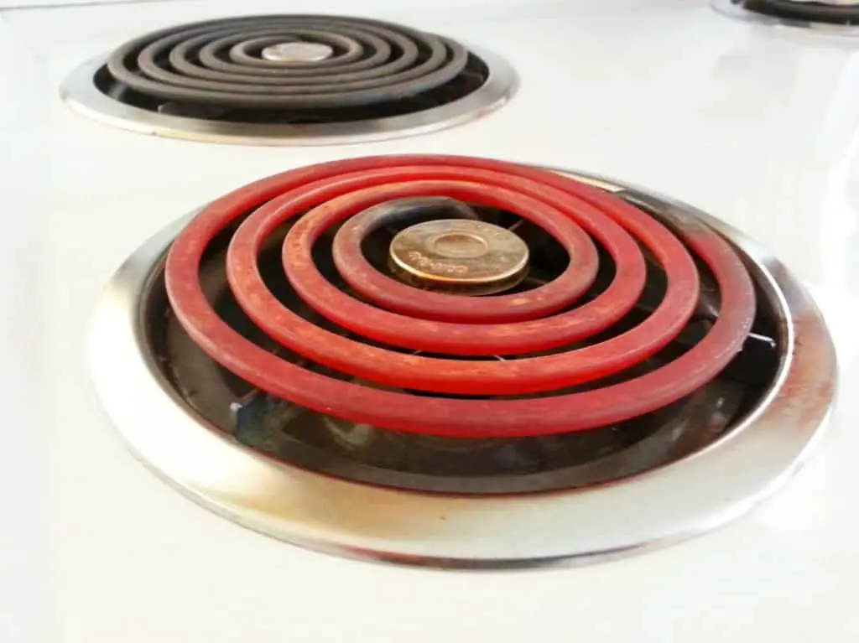
Recap: SW flux, albedo, LW flux, and radiative balance
Energy comes to the earth in the form of shortwave (SW) radiation from the sun, of which a good chunk is visible light. About 30% is reflected away – we say the albedo is 0.3 – without heating anything. The remaining 70% is responsible for heating the planet.
Energy leaves the earth as longwave (LW) radiation emitted by the earth itself. The LW emitted by Earth is invisible to human eyes, but you’re familiar with the basic idea, because you’ve seen glowing coils on a stove top.
When SW and LW energy fluxes are exactly the same, we say Earth is in radiative balance.

Slide 2

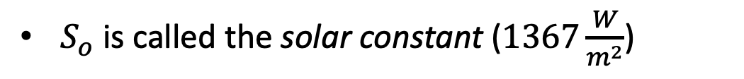

To construct a quantitative model, we’ll start with the absorbed shortwave radiance, or ASR
$S_{o}$ is called the solar constant ($1367\frac{W}{m^{2}}$)
$$S_{o}$$

Slide 3
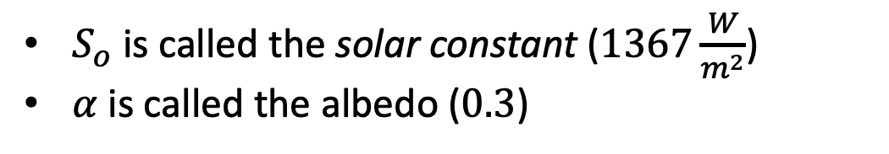

To construct a quantitative model, we’ll start with the absorbed shortwave radiance, or ASR
$S_{o}$ is called the solar constant ($1367\frac{W}{m^{2}}$)
$α$ is called the albedo ($0.3$)
$$α$$
$$S_{o}$$

Slide 4

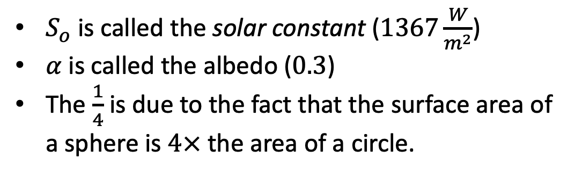
To construct a quantitative model, we’ll start with the absorbed shortwave radiance, or ASR
$S_{o}$ is called the solar constant ($1367\frac{W}{m^{2}}$)
$α$ is called the albedo ($0.3$)
The $\frac{1}{4}$ is due to the fact that the surface area of a sphere is $4×$ the area of a circle.
$$α$$
$$S_{o}$$

Slide 5

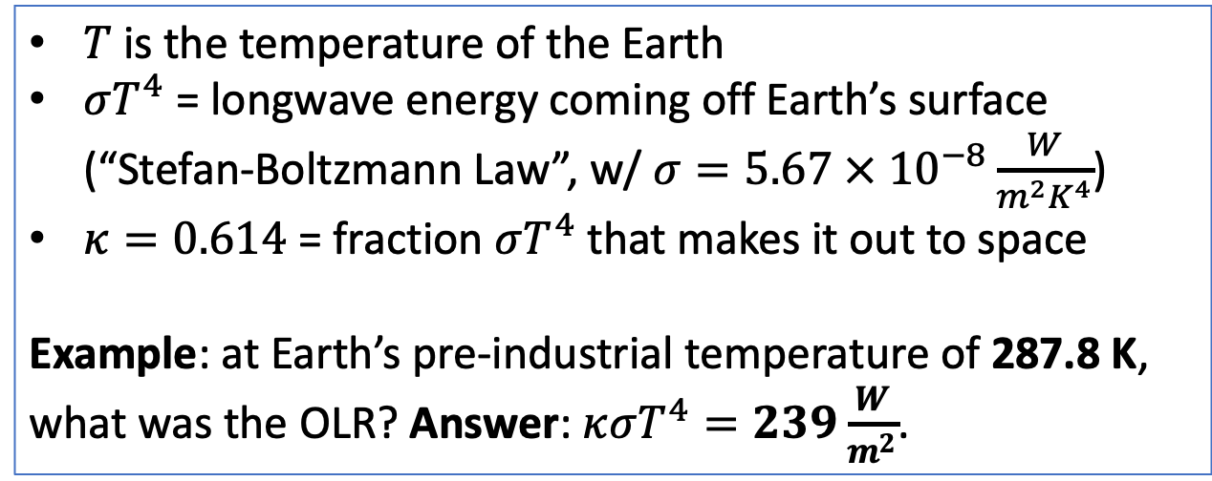

We’ll also need the outgoing LW radiance, which we’ll call OLR
$T$ is the temperature of the Earth
$σT^{4}$ = longwave energy coming off Earth’s surface (“Stefan-Boltzmann Law”, w/ $σ=5.67 × {10}^{−8}\frac{W}{m^{2}K^{4}}$)
$κ=0.614$ = fraction $σT^{4}$ that makes it out to space
Example: at Earth’s pre-industrial temperature of 287.8 K, what was the OLR? Answer: $κσT^{4}=239\frac{W}{m^{2}}$.
The Stefan-Boltzmann law quantifies what you already know: a hot object emits more radiant heat than a cold object does.
$$T$$

Slide 6

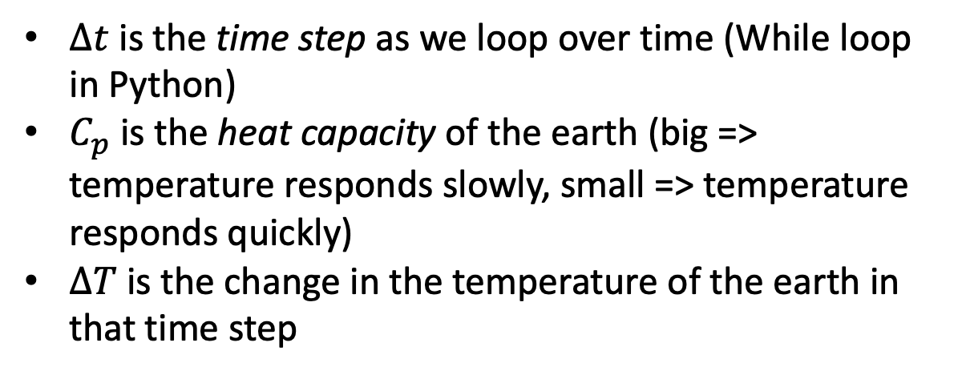
Now for the dynamics: at any given time, any difference between ASR and OLR represents a “radiative imbalance,” which will result in a temperature change
$∆t$ is the time step as we loop over time (While loop in Python)
$C_{p}$ is the heat capacity of the earth (big => temperature responds slowly, small => temperature responds quickly)
$∆T$ is the change in the temperature of the earth in that time step

Slide 7
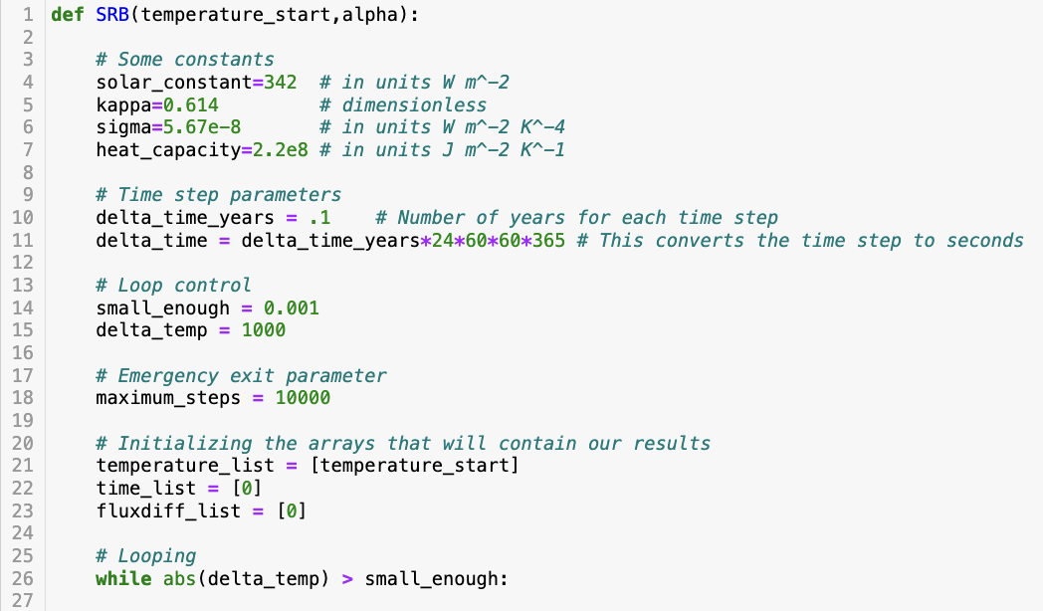
This is already set up for you the “Simple Radiative Balance” exercise, in the form of a function called “SRB”
… more code …

Slide 8
This is already set up for you the “Simple Radiative Balance” exercise, in the form of a function called “SRB”
This is what SRB takes as “inputs”
… more code …

Slide 9
This is already set up for you the “Simple Radiative Balance” exercise, in the form of a function called “SRB”
This is what SRB takes as “inputs”
This is what SRB makes as “outputs”
… more code …

Slide 10
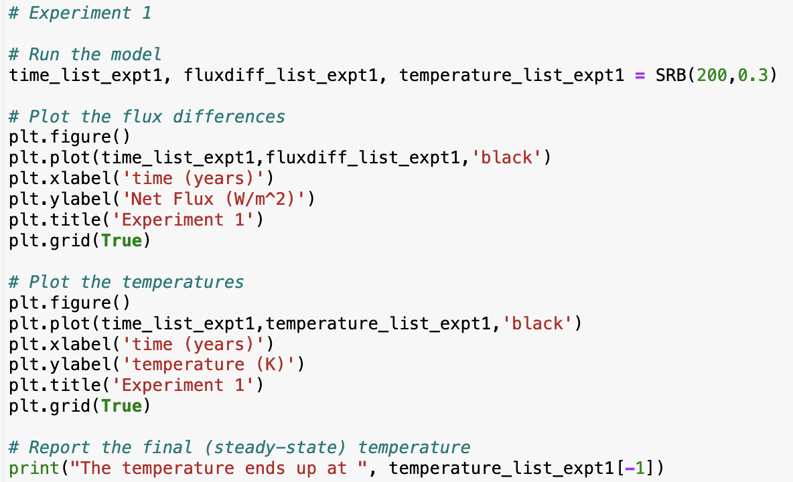
Here’s how you use SRB

Slide 11
Here’s how you use SRB … here are the inputs for this experiment

Slide 12
… and here are the outputs for this experiment (timeline arrays that we can graph)

Slide 13
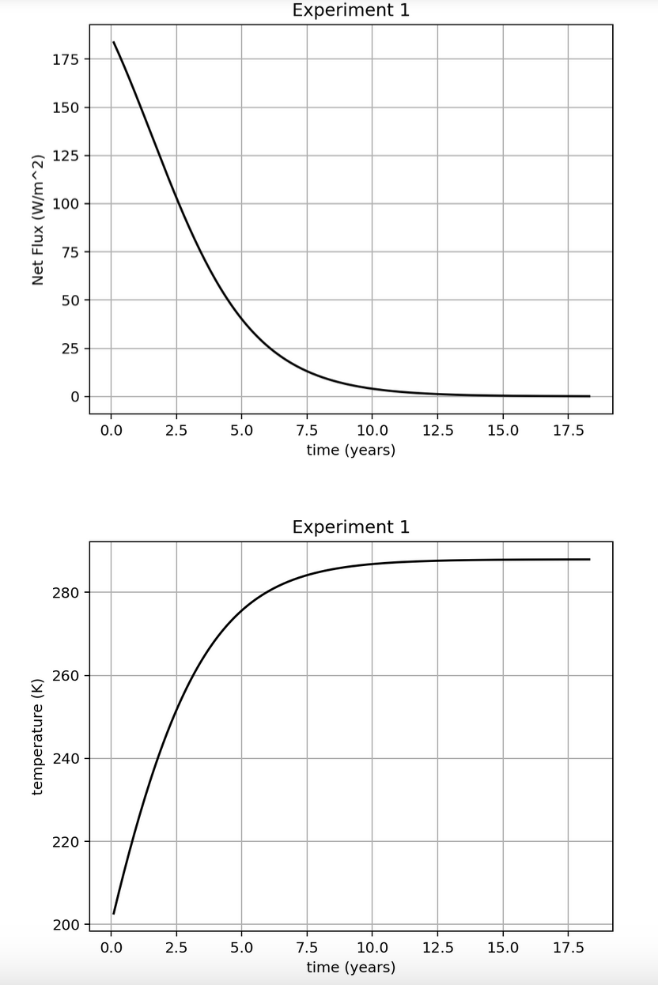
… and here are the outputs for this experiment (timeline arrays that we can graph)

Slide 14
Question: in this experiment, at the beginning, was there more SW energy coming in, or more LW going out? How about the end of the timeline?

Slide 15
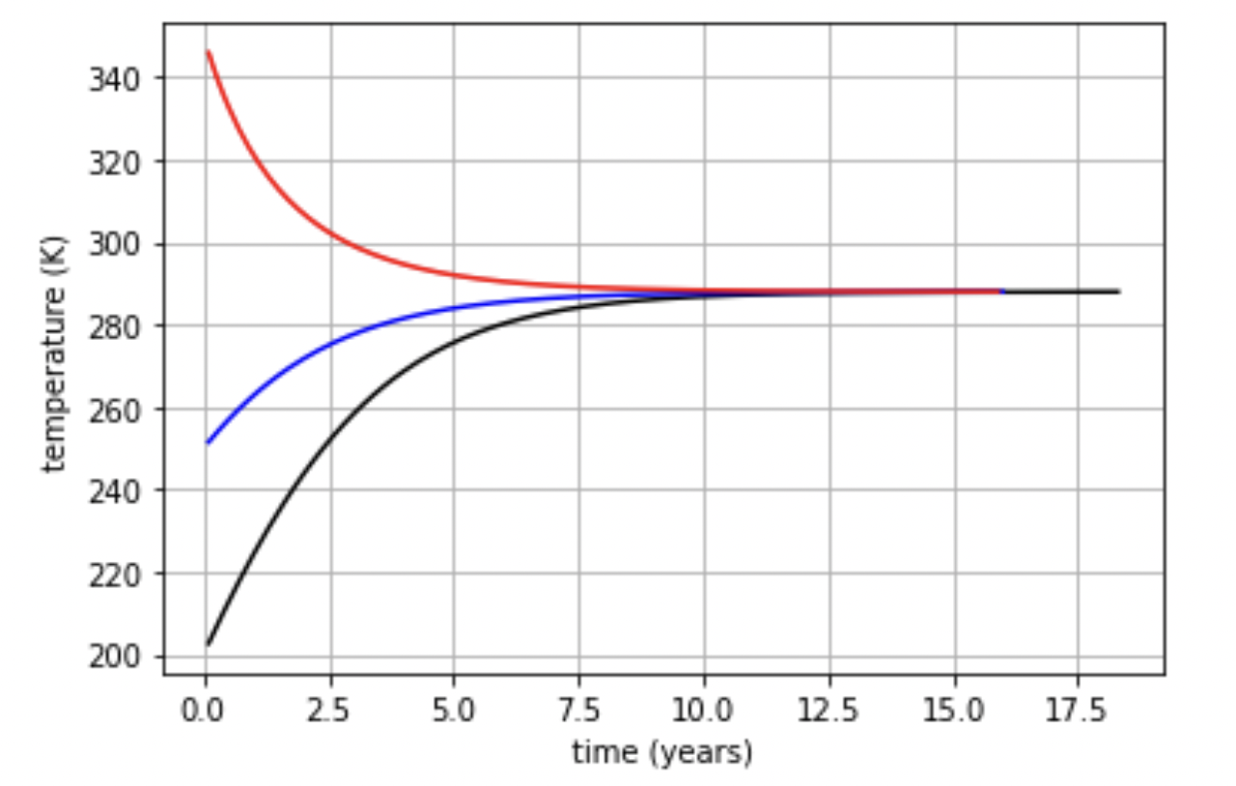
“Stable homeostasis” (or just homeostasis for short) means the resulting state is not sensitive to initial conditions

Slide 16
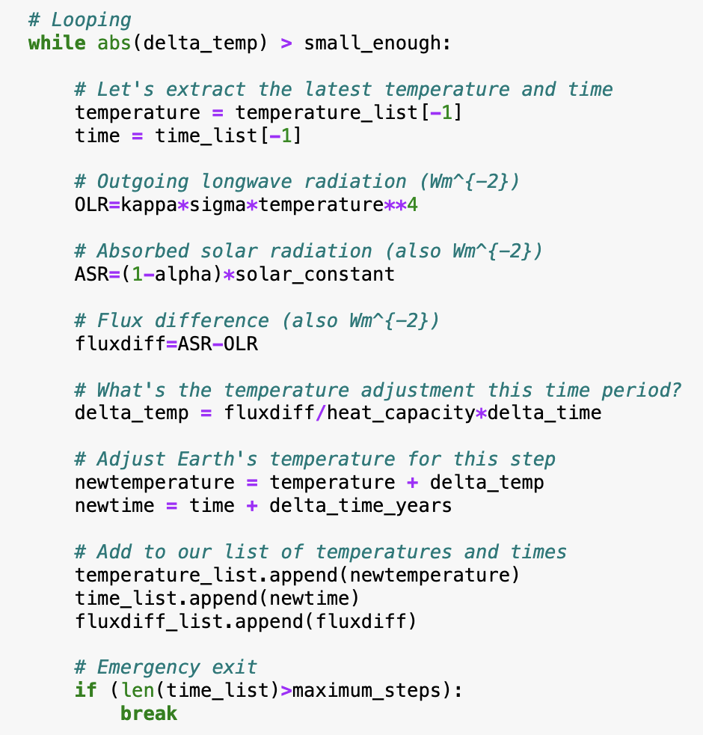
OK, about the nuts and bolts of SRB … all written for you, but some engagement is requested
… more code …

Slide 17
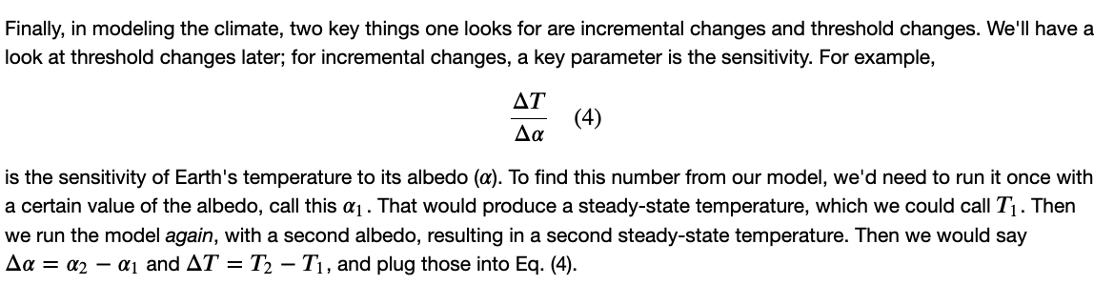
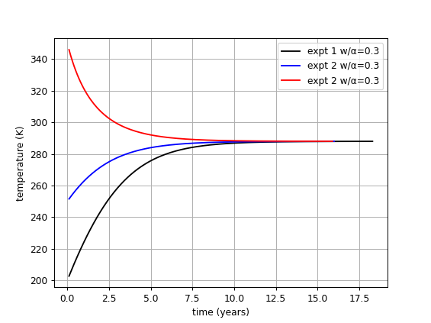
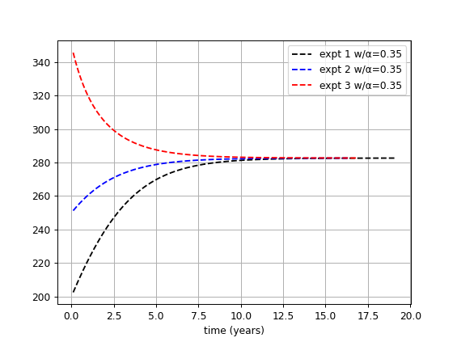
There’s also the climate sensitivity to forcing due to changes in Earth’s albedo

Slide 18
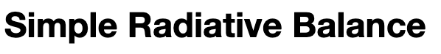
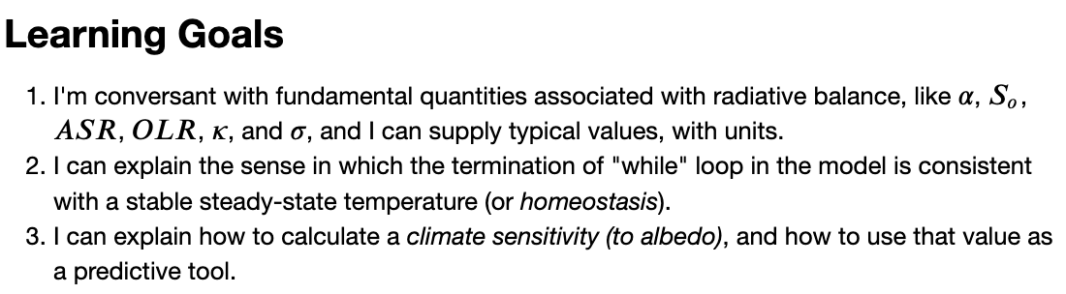
OK, let’s get started

Slide 19
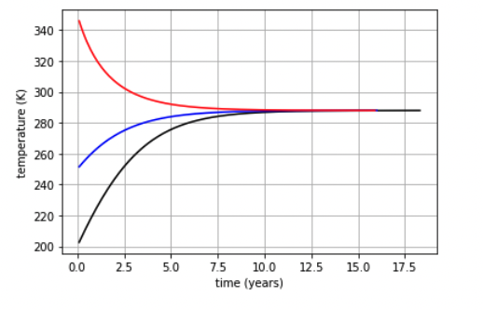
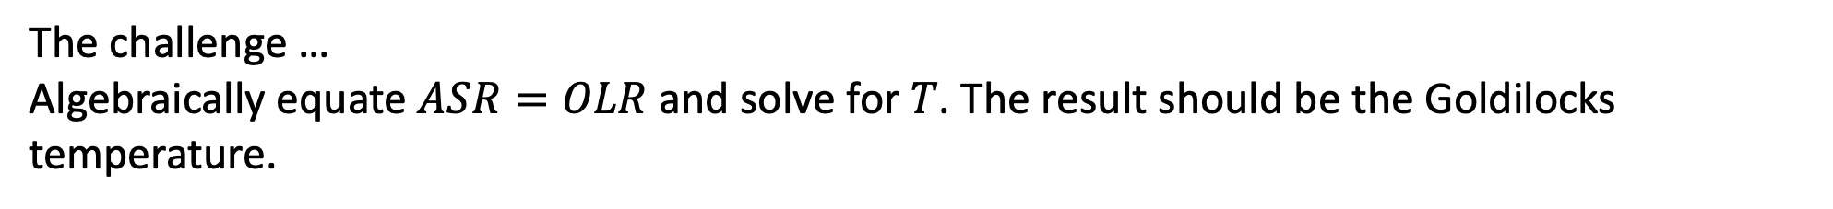
If you finish early, you can try the challenge
The challenge …
Algebraically equate $ASR=OLR$ and solve for $T$. The result should be the Goldilocks temperature.
Goldilocks temperature (when ASR = OLR)

